Slide 1
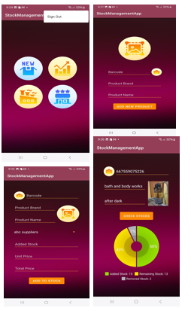
Stock Management Application Efficient Stock and Inventory Management System
Submitted By-
Vignesh Selvaraju - 1225705
Sai Kumar Murugavel - 1210580
Ranton Nigil Roke Keisar-1226620
Kaarthik Sekar- 1218831
Harshita Sharma- 1229053

Slide 2
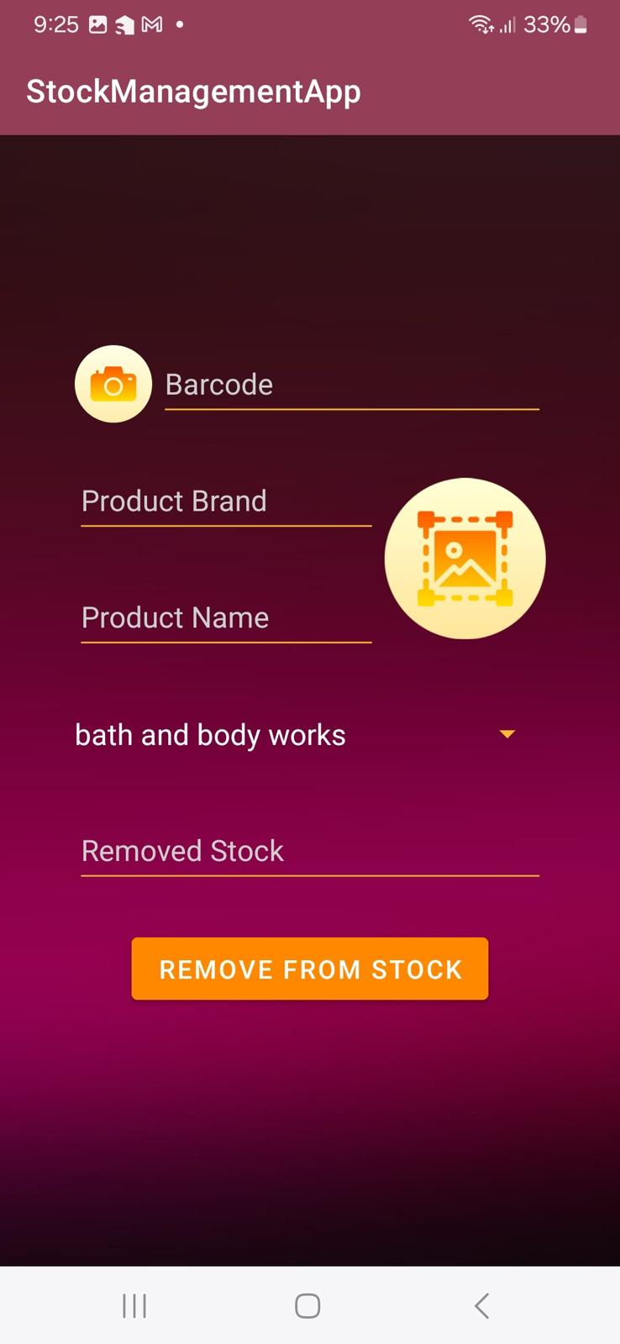
Introduction
Objective:
To develop an app for managing stock, including products, stores, and suppliers.
Scope:
Manage inventory
Track stock levels
Handle product, store, and supplier data

Slide 3
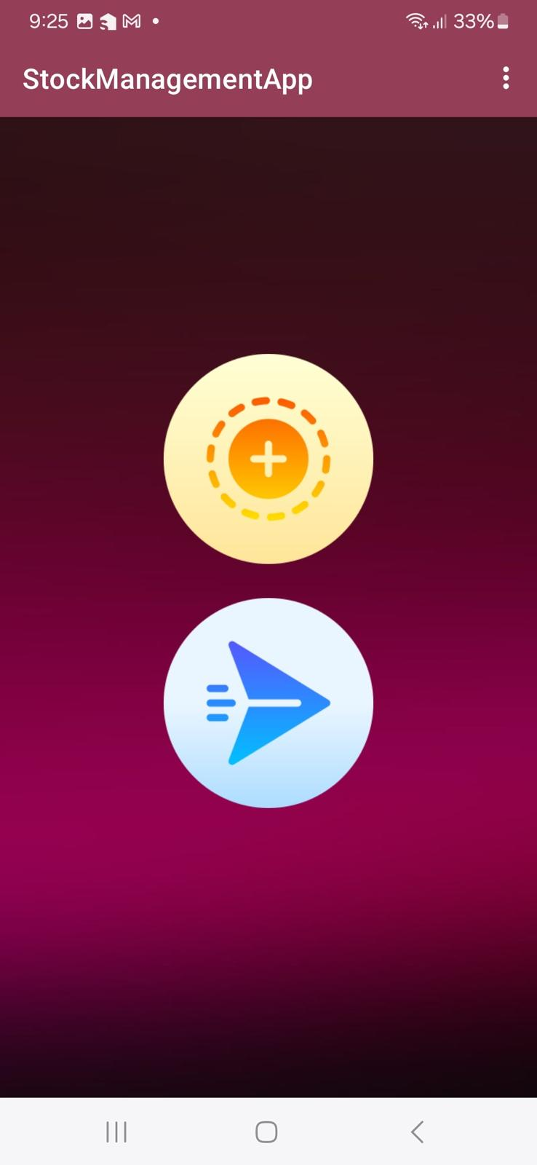
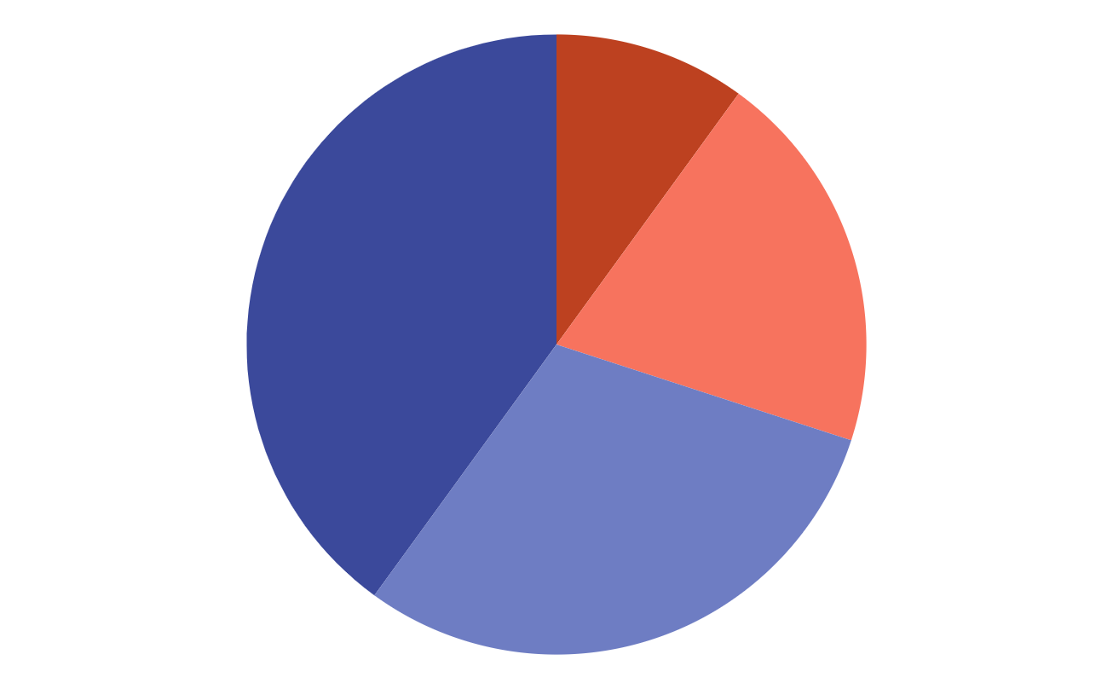
Project Overview
Key Features:
Add, remove, and view stock
Manage products, stores, and suppliers
Barcode scanning functionality
Technology Stack:
Android Studio
Kotlin
Firebase for data storage

Slide 4
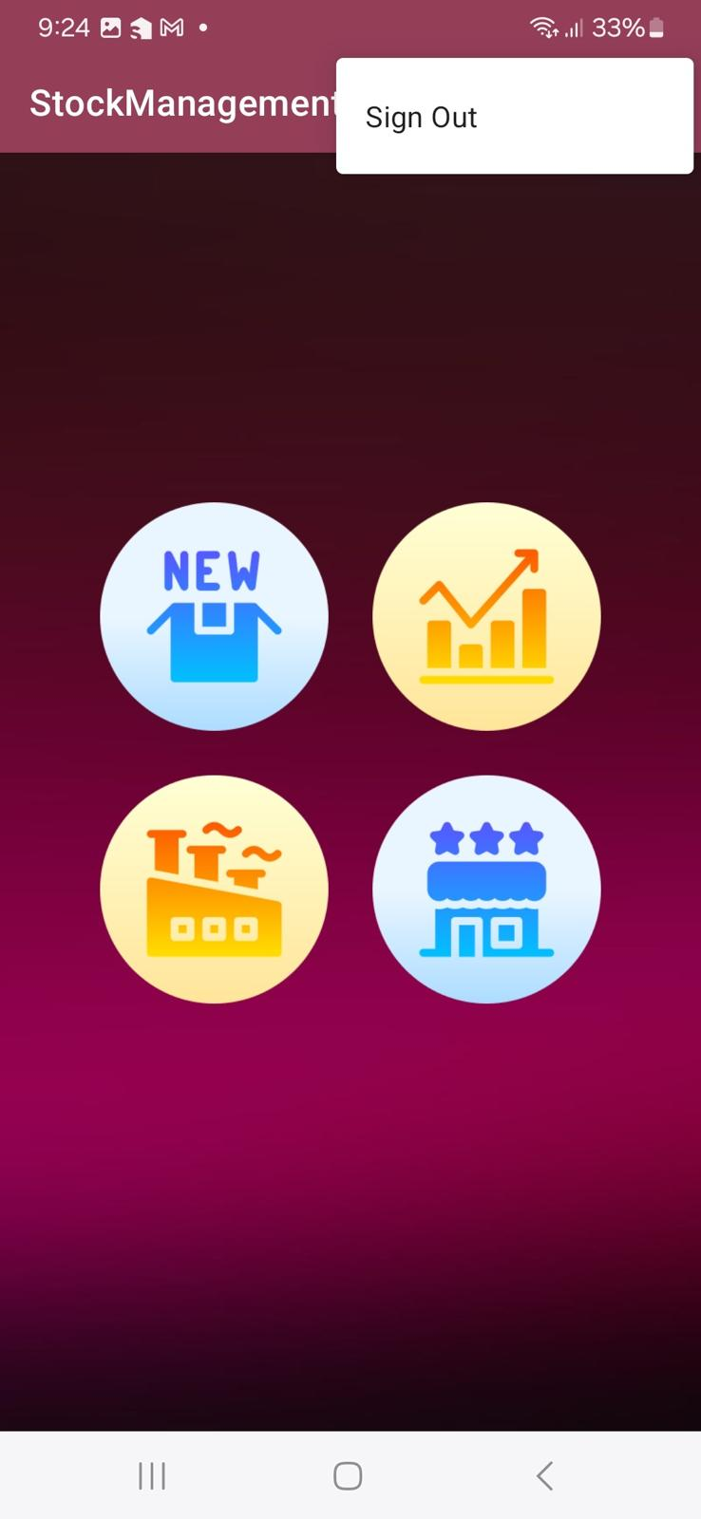

User Interface
Design Principles:
User-friendly navigation
Consistent design language
Responsive layout

Slide 5
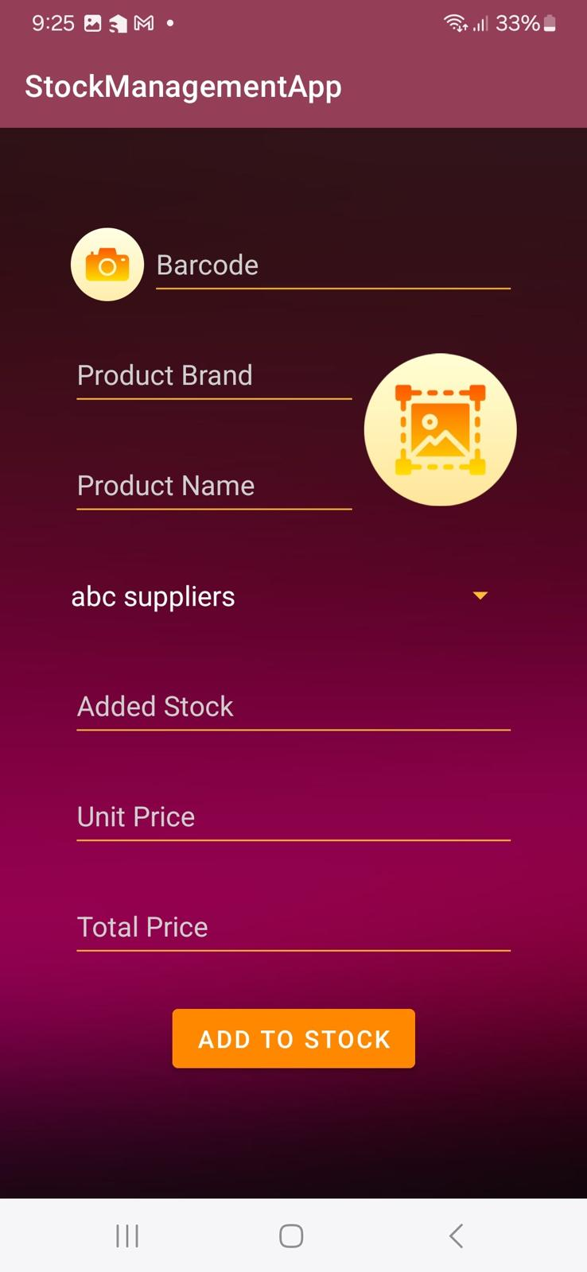
Product Management
Features:
Add new products
View product details
Edit product information
Remove products from stock
Screens
New Product Activity
product List

Slide 6
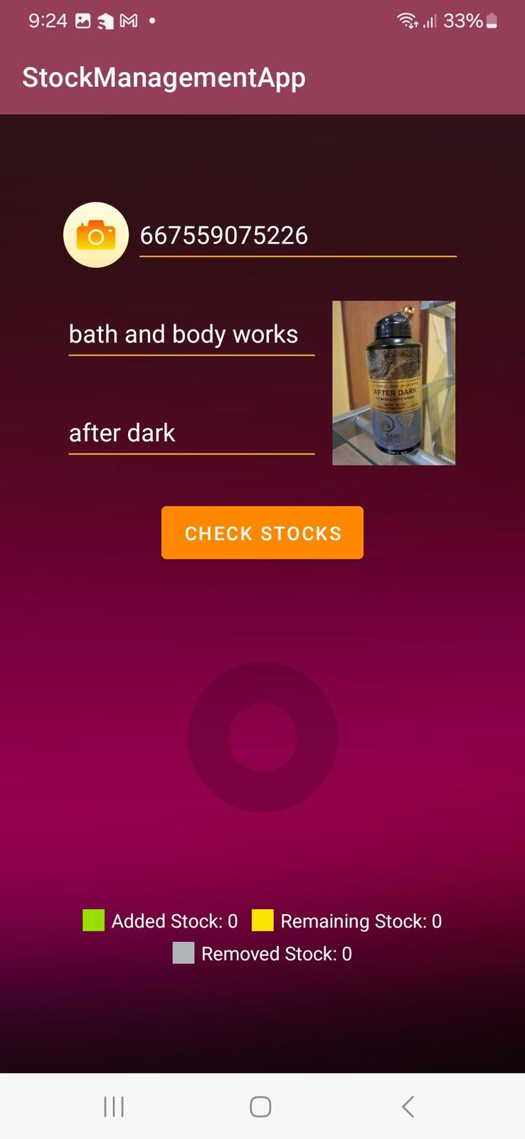
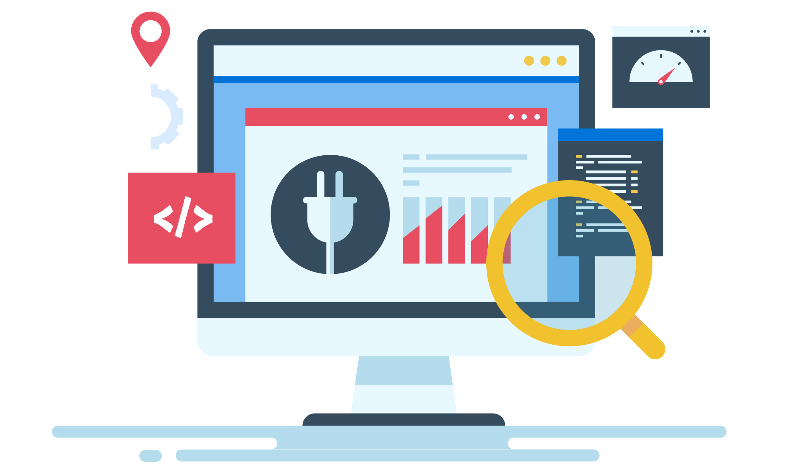
Store Management
Features:
Add new stores
View store details
Edit store information
Screens:
New Store Activity
Store List

Slide 7
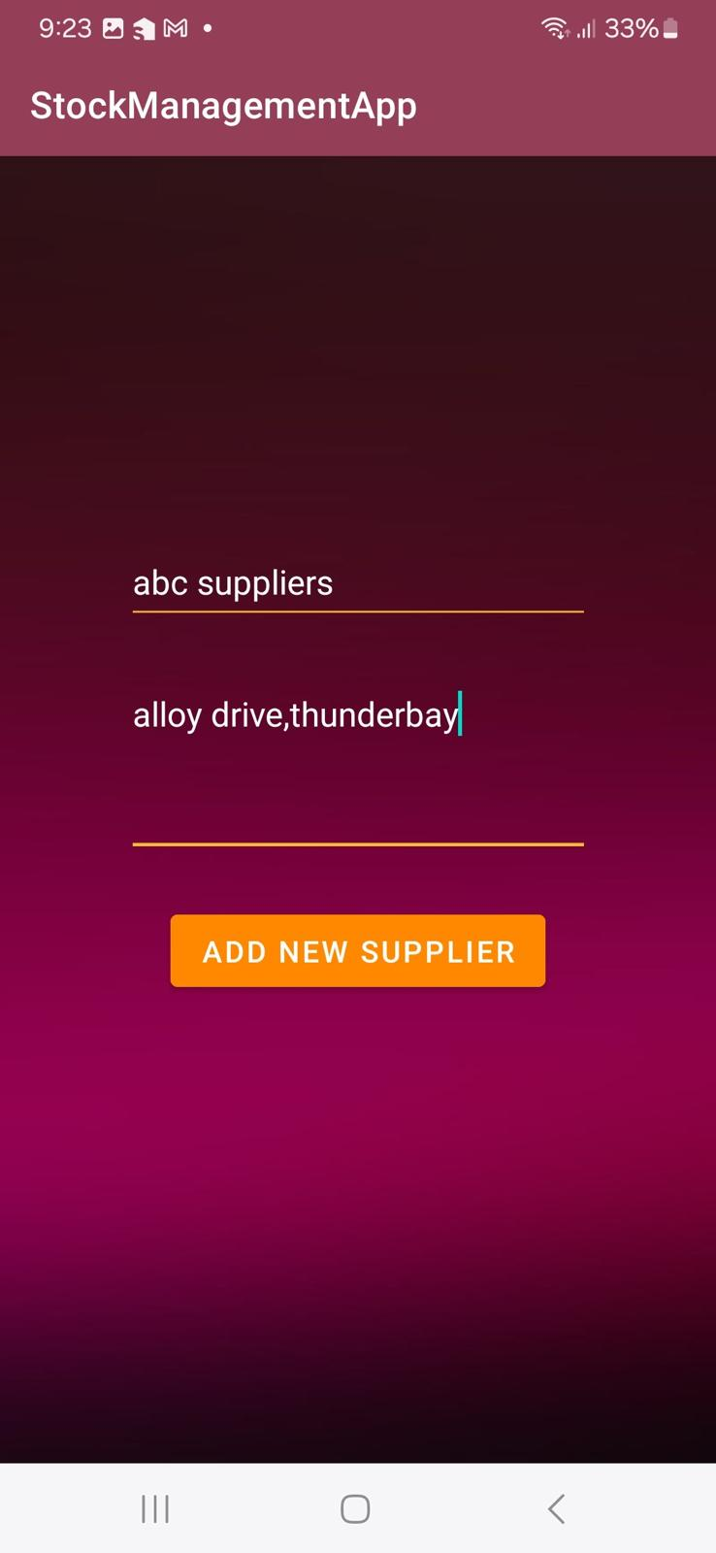
Supplier Management
Features:
Add new suppliers
View supplier details
Edit supplier information
Screens:
New Supplier Activity
Supplier List

Slide 8
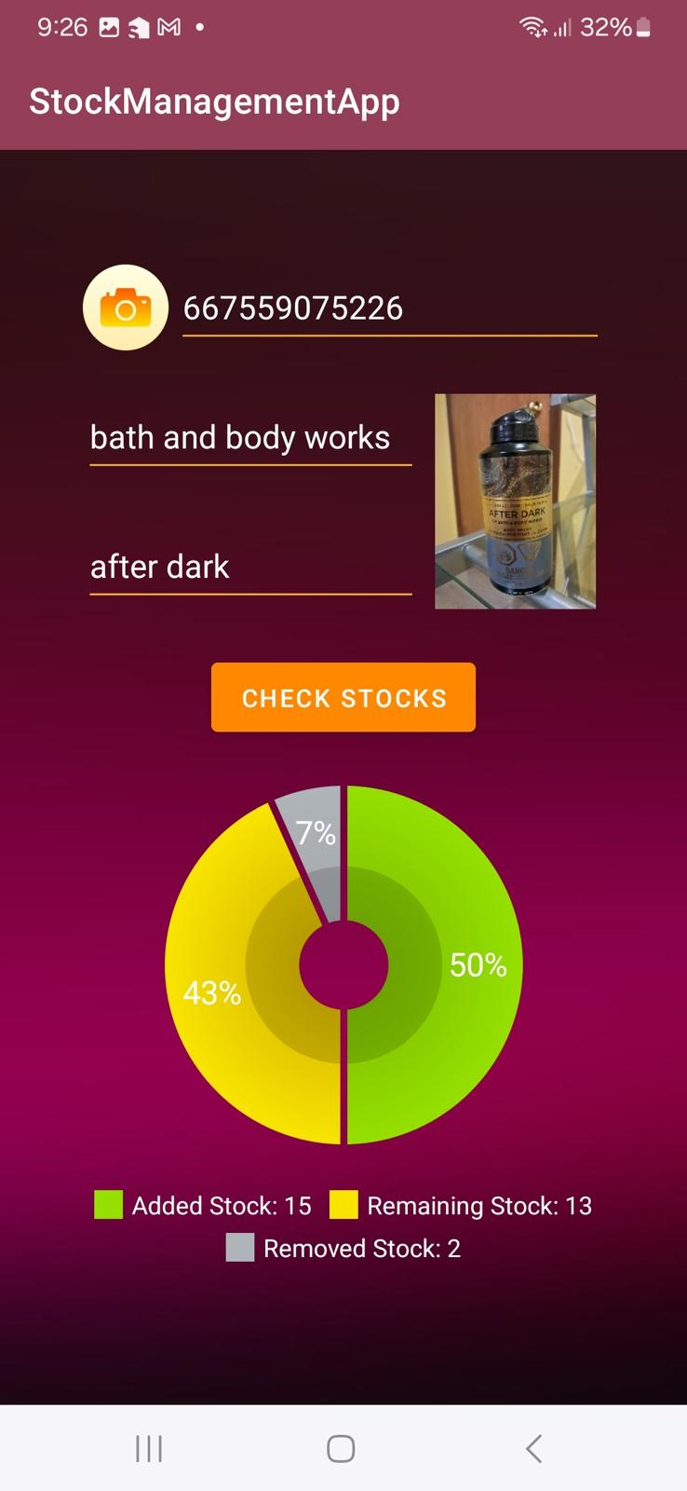
Stock Management
Features:
Remove stock from inventory
Update stock levels
Track stock quantities across stores
SCREENS
Remove stock Activity
Stock Overview

Slide 9
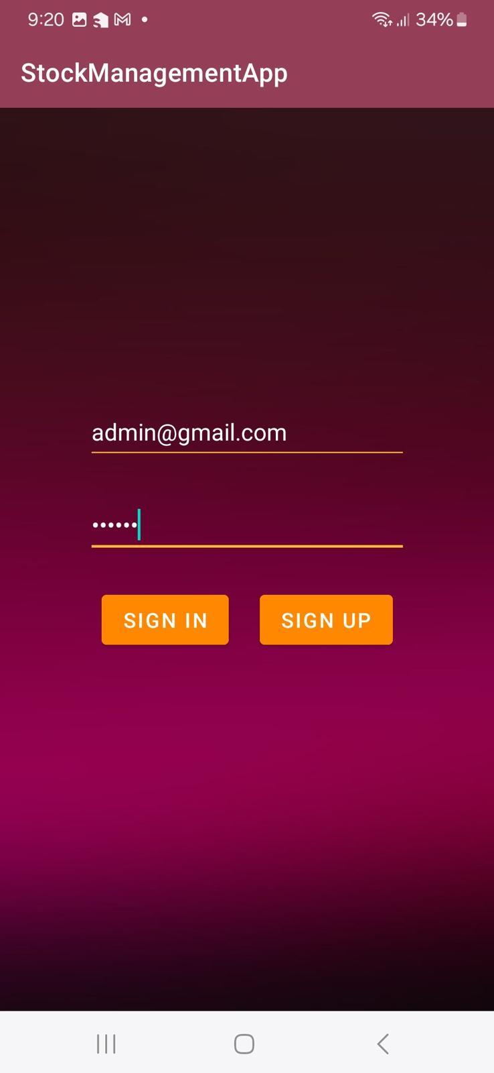
User Authentication and Admin Features
Features
Admin sign-in
Admin functionalities (add/remove/edit products, stores, suppliers)
User Role Management
Screens
Admin Login
Admin Dashboard

Slide 10
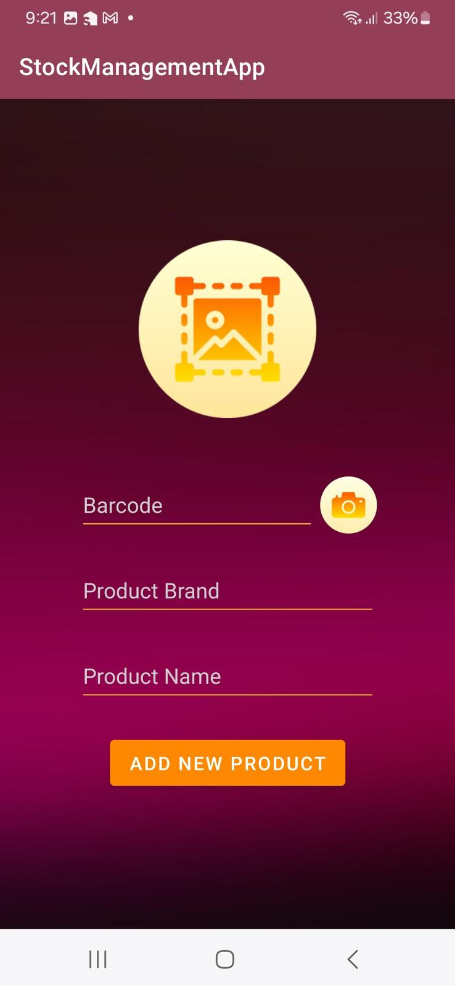
Technical Architecture
Components:
Frontend: Android app UI/UX
Backend: Firebase for real-time database
Integration: Data flow between app and Firebase
Diagram: High-level architecture diagram

Slide 11
Challenges and Solutions
Challenges:
Integrating barcode scanning
Handling large amounts of data
Solutions:
Used Firebase for scalable data storage
Implemented efficient data retrieval and update mechanisms

Slide 12
Conclusion and Future Work
Summary:
Successful development of a stock management app
Meets the core requirements of inventory management
Future Enhancements:
Adding more advanced analytics
Implementing real-time notifications
Enhancing user experience with more features

